Slide 1

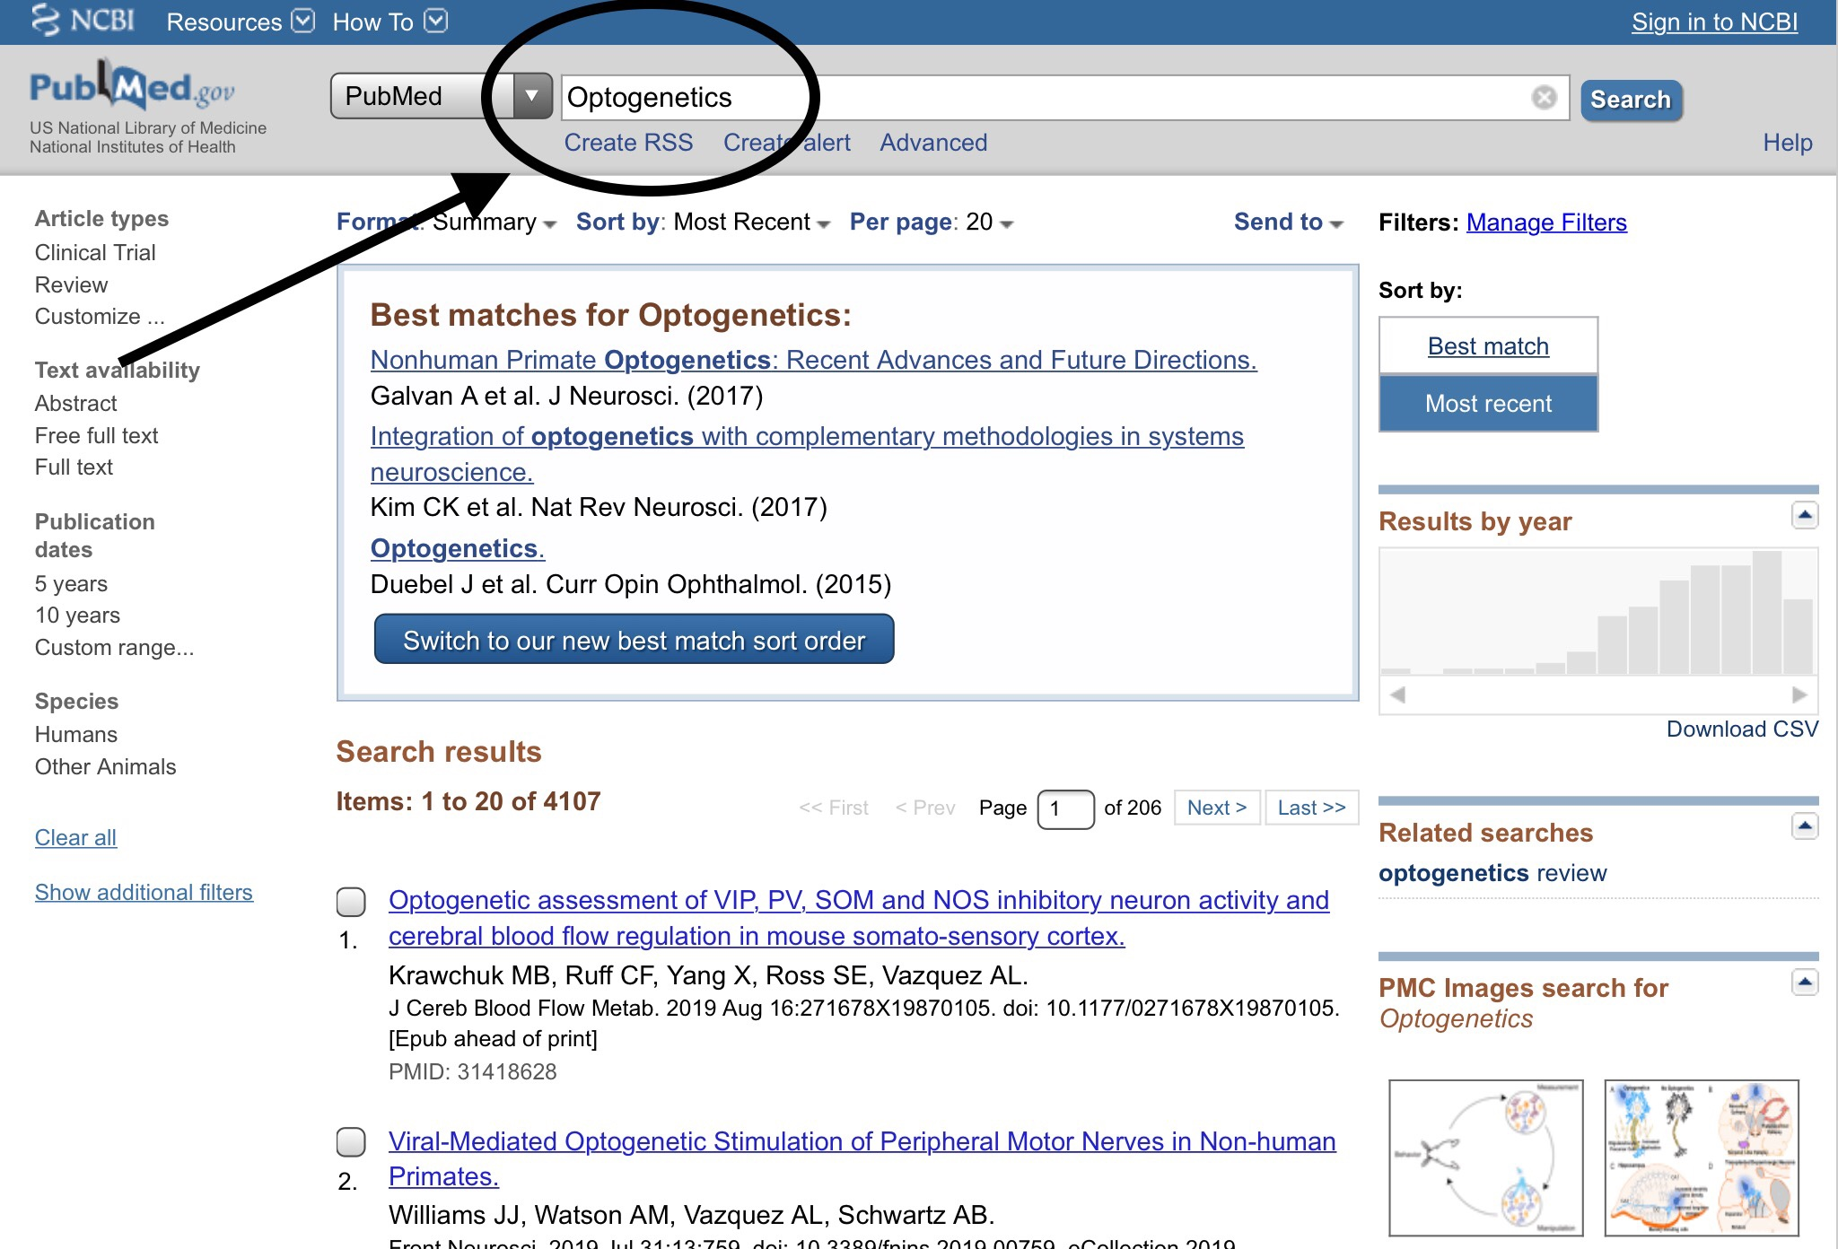
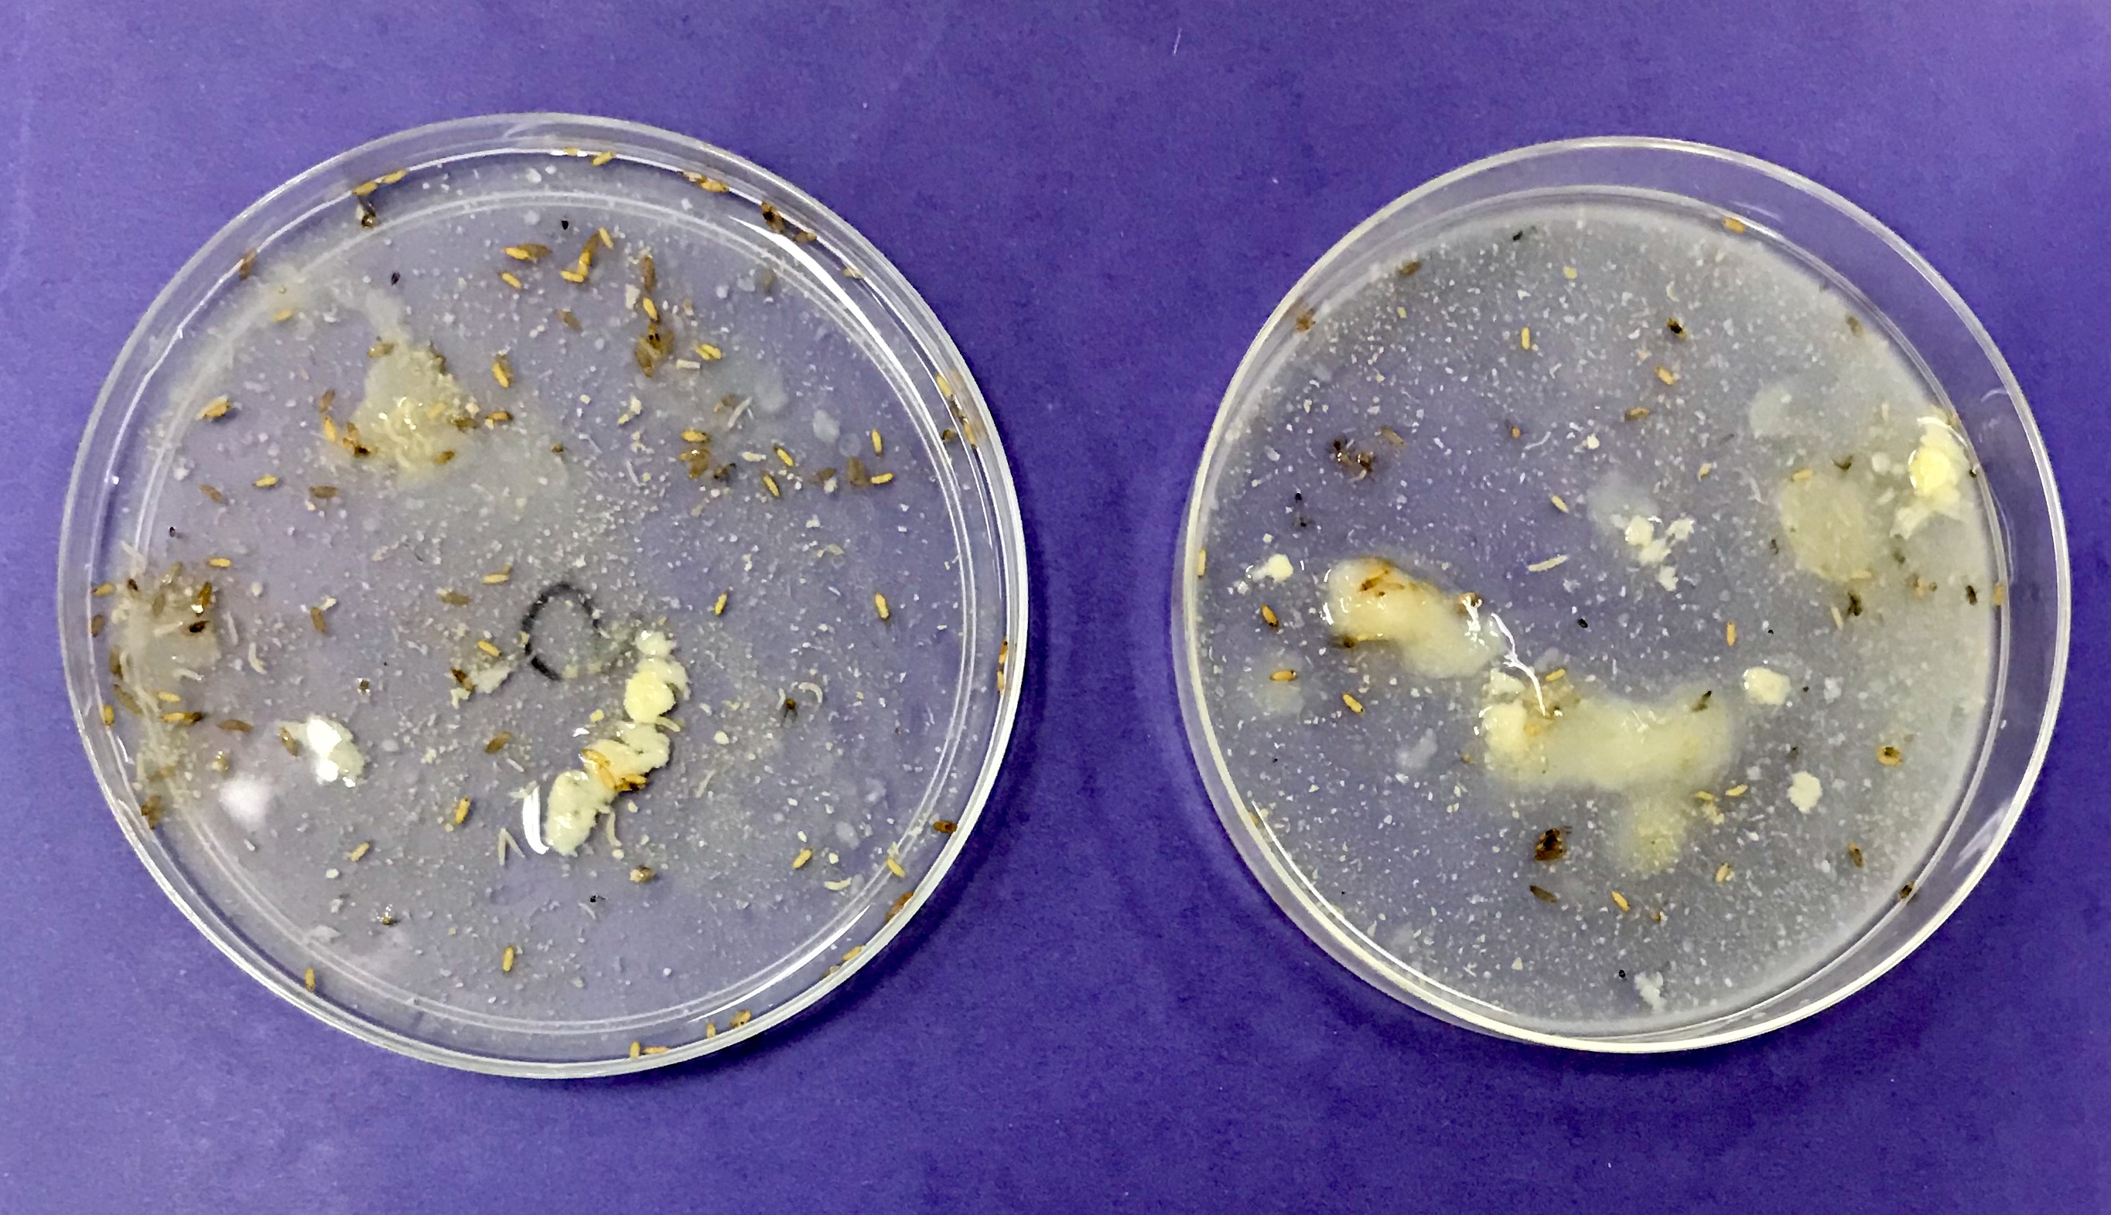
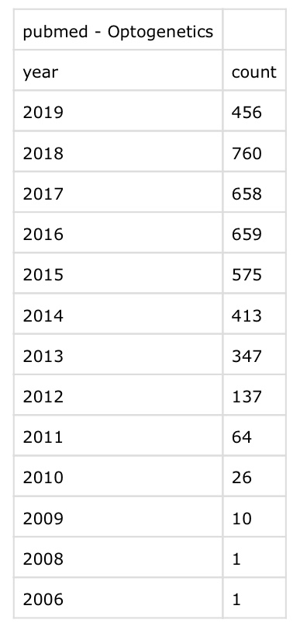
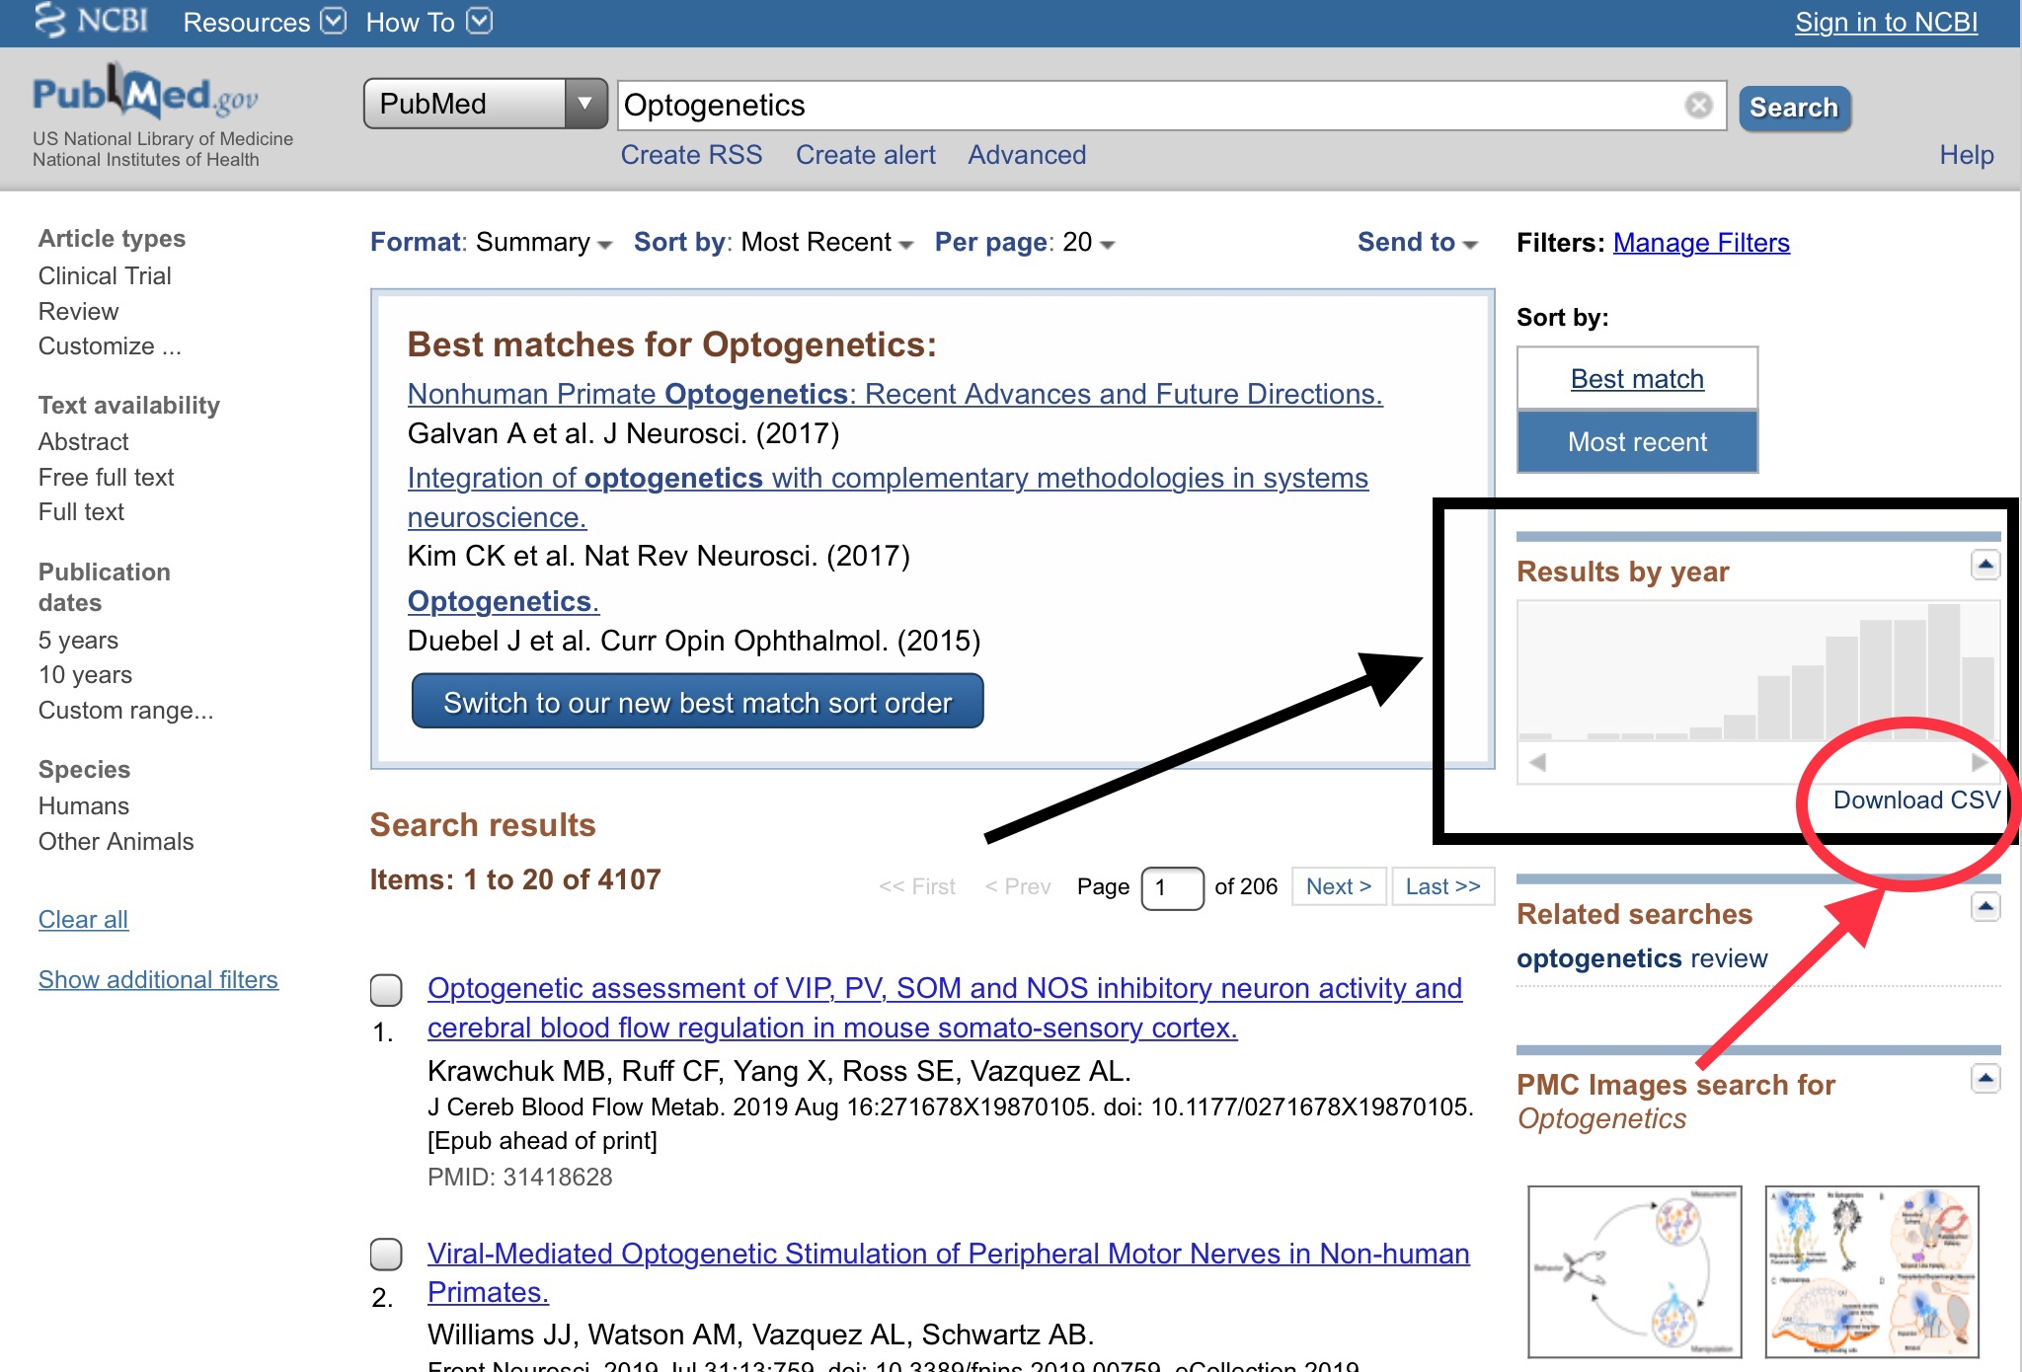
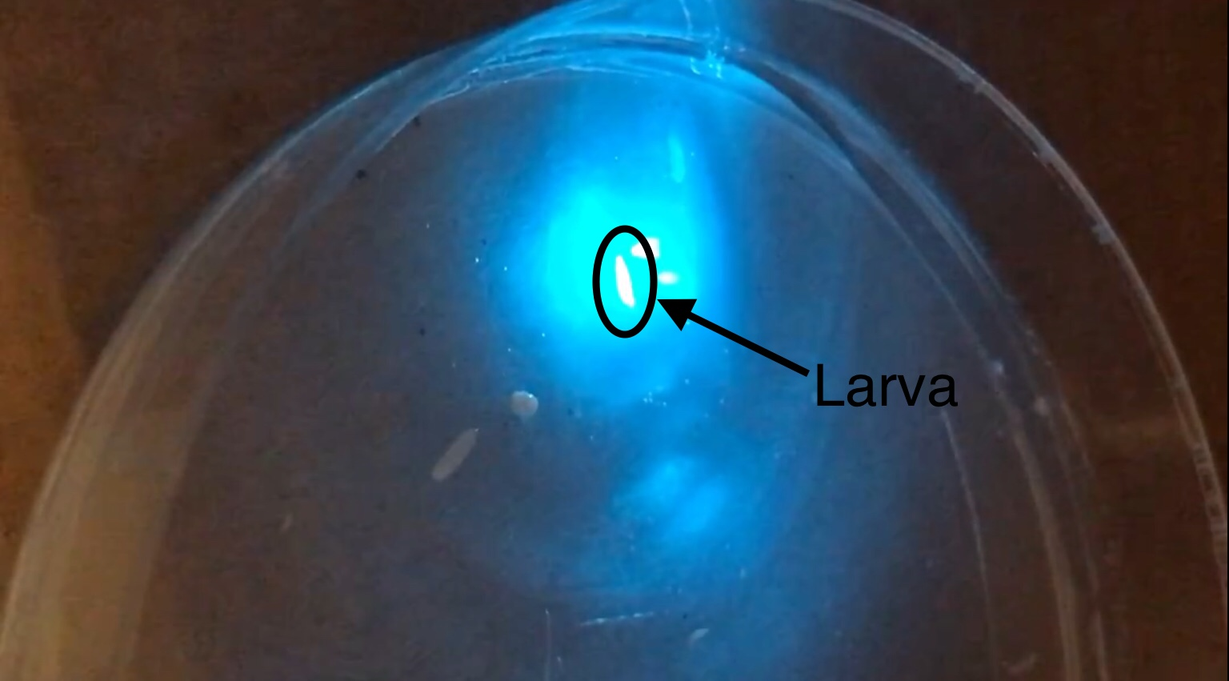
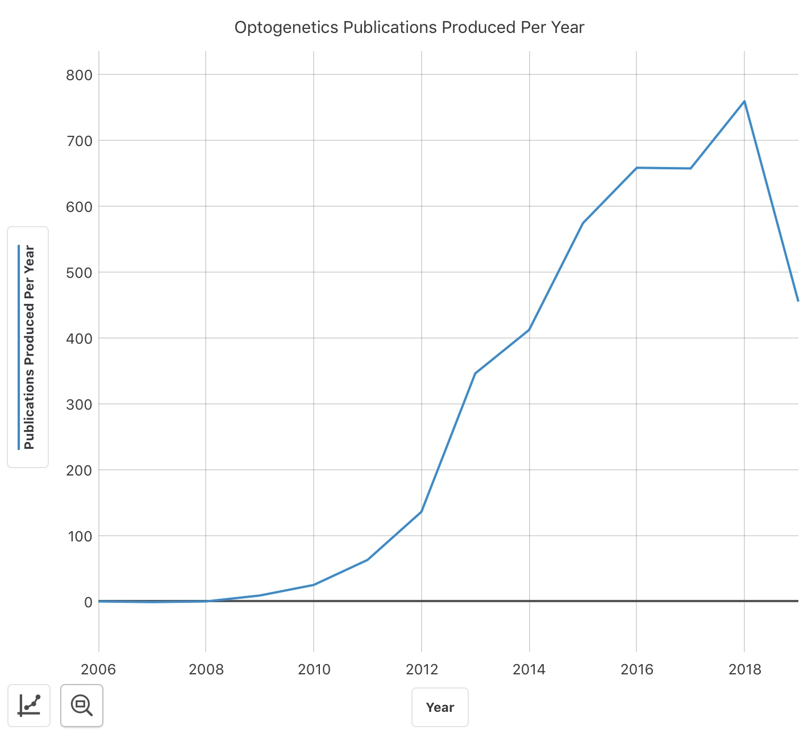
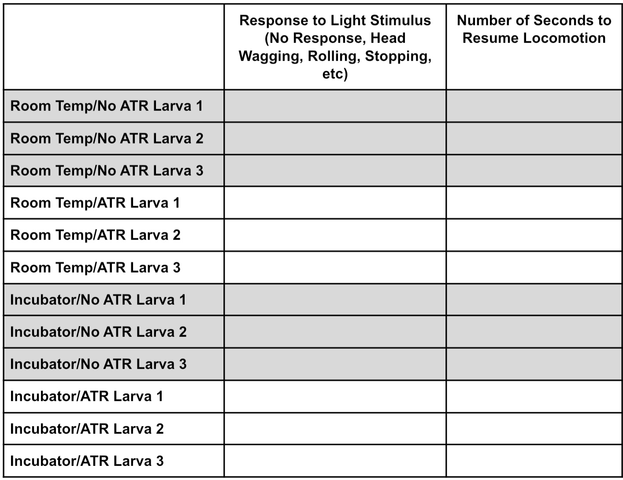
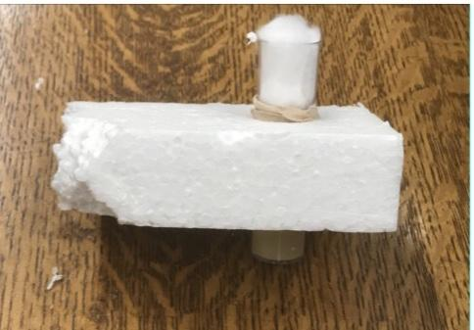
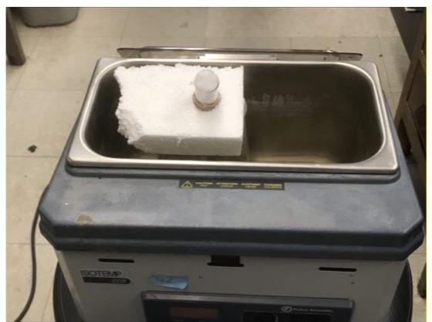
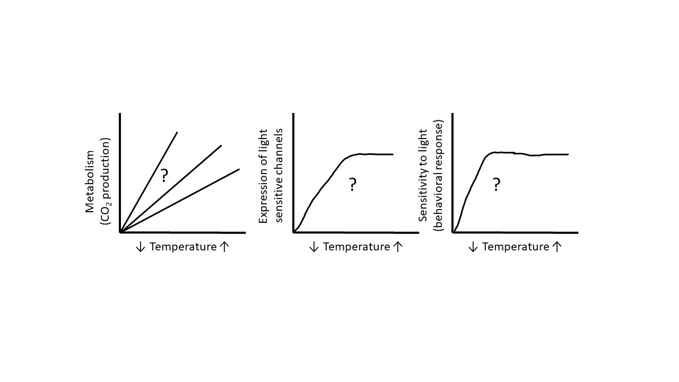
Bridging Optogenetics, Metabolism, and Animal Behavior for Student-Driven Inquiry
Tawny Aguayo-Williams¹, Vaaragie Subramaniam², Doug Harrison², Robin L. Cooper², and Brett Criswell³
¹Department of STEM Education, University of Kentucky, Lexington, KY 40406-0001, USA ; ²Department of Biology, University of Kentucky, Lexington, KY 40506-0225 USA
³Department of Secondary Education, West Chester Univ., West Chester, PA. 19383
Abstract:
Part 1: Experiment Phase
Part 2: Literature Gathering Phase
Teacher Notes:
Biotechnology is an ever-evolving field of science that is instrumental in improving quality of human life, particularly in the medical arena. Optogenetics, an area of biotechnology, involves genetic modification of neurons to express light-sensitive ion channels which allows for use of light to manipulate behavior. This educational module utilizes an approach to bridge optogenetics, cellular metabolism, and animal behavior for student-driven inquiry at high school and college levels. Drosophila melanogaster larvae that have been modified to express Channelrhodopsin-2 (ChR2) in motor neurons serve as models for this module. Students are able to connect temperature, metabolic rate, and gene expression through data collection of behavioral responses to light stimuli exhibited by larvae stored in various temperatures. Students are also able to observe the role of cofactors in metabolic processes via larvae that have been fed all-trans retinal (ATR), which is a cofactor to ChR2. The final component of the module allows students to form connections between the application of neuroscience as exhibited in the module to trends in scientific publications related to optogenetics.
For this portion of the module, we suggest that teachers prepare the larvae into labeled bottles and store them under their various conditions (different temperatures and diet with or without ATR) prior to the experiment. Students can then engage the remainder of the hands-on preparation and experimental activities that mimic what occurs in a research laboratory.
After being placed into pairs, students begin the experiment by selecting the bottle containing larvae that have been stored at room temperature and fed food without ATR. Students use a scoopula to transfer a portion of food from the bottle onto a Petri dish and then dilute the food with water to locate the larvae.
After transferring three larvae into a Petri dish containing a small amount of apple juice (this encourages the larvae to crawl), students begin the process of shining blue light onto each larva for ten seconds and noting the response to the stimulus. After ten seconds of stimulus, students then time how long it takes for each larva to resume locomotion.
This process is repeated using larvae stored at room temperature with food containing ATR, larvae stored in an incubator with food that does not contain ATR, and larvae stored in an incubator with food containing ATR.
Students can utilize a data table such as the one depicted below to document their findings. We then suggest that students utilize the data table to create a graph of their choosing to communicate the results of the experiment. The guide we have created includes questions for teachers to utilize to direct discussion as groups present their findings.
This portion of the module involves utilizing PubMed, a database for scientific publications, to search for key words related to the concepts the module addresses. The guide includes numerous word suggestions (i.e. optogenetics, channelrhodopsin, transgenic organisms, etc) but should be adjusted for the number of students/groups participating in the module.
Students visit the PubMed website (pubmed.gov) and search for their assigned term. Publications related to the term will be included in the search results.
Students can view the number of publications produced per year about their topic and create a graph reflecting the results. They can point out any trends that exist, such as increases or decreases in numbers of publications, and formulate conclusions regarding the trends.
Students then review the first three pages of search results to observe any trends within the publications. Because optogenetics currently plays a role in the neuroscience realm, the majority of observations will likely pertain to the prevalence of publications addressing medical issues. This serves as a great segue into discussions of practical applications of optogenetics, such as its use in combatting the effects of Parkinson’s disease, epilepsy, and even blindness.
Because this module incorporates a variety of sciences, including cell biology, genetics, medicine, biotechnology, and animal behavior, there many directions that class discussions can take. Examples include:
Metabolism and optimal conditions required, including temperature and pH
Cofactor involvement in metabolic processes
Metabolism in endotherms versus ectotherms
Transgenic organisms and genetically-modified organisms
Biotechnology and practical applications
Process of scientific inquiry
This module can easily be manipulated in complexity to effectively teach higher and lower-achieving students. For higher-achieving students, one could have them test additional variables outside of those listed in the procedures, such as larva reaction to different wavelengths of light, response of larva stored under a larger variety of conditions, etc. They could also write a more in-depth report or paper based on results from the literature gathering phase of the module. Lower-achieving students might benefit from additional pre-assessment review, such as reviews of metabolism, cofactors, and other key terms in this module. One could also choose to have them complete only one phase of the module instead of both.
The guide for the module can be found at:
http://web.as.uky.edu/Biology/faculty/cooper/ABLE-2021/ABLE-2021-Metabolism%20and%20gene%20expression/Home-metabolism%20and%20gene%20expression.htm
Screenshot from PubMed.gov using “optogenetics” as search term
Petri dishes containing food diluted with water to make larvae visible
Introduction:
This module focuses on creating a meaningful educational experience that aligns biotechnology, metabolism, and scientific inquiry for students in biology classrooms at high school and college levels. Students are able to experience phenomena while enhancing data interpretation skills and graphical literacy. The latter component of the module focuses on connecting knowledge gained from the experimental phase to practical applications in neuroscience.
Direct involvement with methods of inquiry is crucial for students to gain an understanding of both the phenomenon being taught as well as how scientific knowledge is gained (National Research Council, 2012). The module provides opportunities for students to engage in the inquiry process through an experiment involving optogenetics and the testing of the behavioral responses of D. melanogaster larvae stored under various conditions to light stimuli. Students utilize a data table to collect their findings, and then are asked to create a graph reflecting the information. Students engage in the science and engineering practices of NGSS through carrying out an investigation, analyzing and interpreting data, and communicating the results of their experiment.
Despite many important global topics being presented in the form of graphs and data compositions, a deficit in data and graph literacy exists in classrooms as many students struggle with interpretation and production of data (Carlson, Fosmire, Miller, & Nelson, 2010). Student learning is enhanced when they are presented with real-life situations that are applicable to them or hold a certain level of interest (Premadasa & Bathia, 2013). The second portion of the module that addresses both aforementioned concepts involves review of scientific literature related to the topic of optogenetics. Students look for trends that exist in both numbers of publications per year as well as topics of publications and create graphs based on their findings. Students are able to gain knowledge regarding practical and interesting applications of optogenetics while strengthening literacy skills.
A thorough guide has been created for teachers and students that includes detailed steps for completion of the module. In addition, the guide provides alternative, cost-effective options for laboratory equipment that may not be available in all classrooms. The guide promotes additional scientific inquiry through suggestions of supplementary variables students can test if time and resources allow.
Screenshot from PubMed.gov reflecting number of publications per year after clicking “download CSV”
Screenshot from PubMed.gov reflecting number of
publications per year
Summary
Larva being stimulated with blue light
This module allows students to engage in science and engineering practices through conduction of an investigation, data collection and interpretation, and communication of results.
Hands-on experimentation and literature gathering related to optogenetics exposes students to practical and interesting applications of biotechnology. This allows for meaningful discussions that students will likely find compelling.
This module would work well in a biology or integrated sciences lesson at high school or introductory college levels. It encompasses information from and bridges a wide variety of sciences, including cell biology, genetics, medicine, biotechnology, and animal behavior.
The experimental phase of the module can be adapted to include additional variables for students to test if time and resources allow.
The literature gathering phase of the module can easily be translated to other lesson plans of different topics, allowing students to gain exposure to many concepts in the scientific realm.
Sample graph created using Graphical app
…. Additional Preparation Considerations
If unavailable, a water bath could be used in lieu of an incubator.
Prepare flies into vials as described in larvae preparation instructions on Page 4.
Take a rectangular piece of styrofoam and make a hole in the middle about the same size as the vial containing the larvae. The bottom of the vial containing the food should be submerged in the water after being inserted into the styrofoam.
Place rubber bands around the portion of the vial above the styrofoam so that the vial cannot slip through the hole.
Learning Objectives:
a
References
Students will be able to explain what a transgenic organism is.
Students will be able to form hypothesis on how optogenetics can be used to manipulate locomotion in Drosophila melanogaster larvae.
Students will be able to explain how temperature and cofactors play roles in metabolic processes.
Students will be able to describe practical applications of biotechnology, particularly optogenetics.
National Research Council. (2012). A Framework for K-12 Science Education: Practices, Crosscutting Concepts, and Core Ideas. (2012). Committee on a Conceptual Framework for New K-12 Science Education Standards. Board on Science Education, Division of Behavioral and Social Sciences and Education. Washington, DC: The National Academies Press.
Carlson, J., Fosmire, M., Miller, C., & Nelson, M. (2011). Determining Data Information Literacy Needs: A Study of Students and Research Faculty. Portal : Libraries and the Academy, 11(2), 629-657.
Premadasa, K., & Bhatia, K. (2013). Real Life Applications in Mathematics: What Do Students Prefer? International Journal for the Scholarship of Teaching and Learning, 7(2).
b

